Slide 1

UGA
Centralized Classroom Scheduling
Information session:
Policies, Procedures, and
Best Practices

Slide 2

What is Centralized Classroom & Event Scheduling
?
  Central Scheduling is a collaborative mission to maximize classroom utilization equitably and judiciously to provide the best possible outcome for student success.
  The Centralized Classroom and Event Scheduling Policies, Procedures, and Processes are available on the Office of the Registrar’s website.
  Centralized Classroom and Event Scheduling Policy
  Centralized Classroom and Event Scheduling Process

Slide 3
Central scheduling classroom terms
  Pre-Designated, Centrally-Coordinated Classrooms
    Classrooms that are pre-designated to a department. Departments can pre-load courses in these spaces before the mass central scheduling process. After the mass central scheduling period, the Registrar’s Office and Campus Reservations, Events, and Technical Services (CRETS) can schedule courses and events in these rooms.
  Pre-Designated, Non-Centrally Coordinated Classrooms
    Classrooms that are exclusively controlled by the designated department. No department can load courses or events in these spaces without permission from the controlling department.
    ***Adding these spaces in Banner and/or 25Live does NOT change their classification. They are still exclusively controlled by the department.***

Slide 4
Central scheduling classroom terms
  Provost Centrally-Coordinated Classrooms
    Classrooms that are exclusively controlled by the Provost. The Registrar’s Office and CRETS are the only departments permitted to reserve these spaces, such as the Miller Learning Center and Instructional Plaza.
  Active Learning Classrooms
    Active Learning classrooms have multiple features. Please list the specific features that an instructor needs when requesting an Active Learning space.
  Event Spaces
    Rooms that are exclusively used for events and fees are involved. Courses are not permitted to be scheduled in these locations, which are primarily managed by CRETS. (Memorial Hall, Tate Theater, the Chapel, etc.)

Slide 5


What is 25Live?

Slide 6
How can I use 25live?
25Live is the web application utilized by
the University of Georgia for
building and room scheduling.
Check the schedule in your pre-designated space
Schedule your departments events in your pre-designated spaces
Use the handy event calendars to manage your spaces
View Basic
Course information
Submit requests to reserve rooms for events
View the seating, technology, and images of any centrally schedulable classroom
Search tools for events, courses, and available classrooms
View Final exam
room assignments

Slide 7
How are building and rooms managed in 25Live?
The Registrar’s Office is responsible for managing classroom data in 25Live.
If you need a building and/or room added in 25Live for scheduling, please email classrooms@uga.edu.
We survey classrooms during spring break and the summer term to collect current data and images of classrooms to import into 25Live.
If your predesignated spaces are being renovated, please let us know as soon as possible. This will allow us to block the room from course or event scheduling.
The Registrar’s Office has no control over classroom furniture or technology. Please contact the pre-designated department for assistance with those concerns. We are glad to relocate your course if the room features are not suitable.

Slide 8
Scheduling Events in 25Live
The 25Live
Classroom Scheduing Tutorials
are located on the Registrar’s Office website.
Watch the tutorials and follow the instructions on obtaining access to 25Live to schedule events in your department’s pre-designated rooms.

Slide 9
Scheduling Events in 25Live
What are Academic Course-Related Events?
Faculty-led events for students enrolled in credit-bearing courses. An active CRN is required. (Ex. Review sessions, film screenings, makeup tests, etc.)
What is NOT an Academic Course-Related Event?
Orientation, faculty office hours, student-led events, meetings, seminars, guest speakers, etc. These are processed by Campus Reservations, Events, and Technical Services.
Who is allowed to submit an Academic Course-Related event request?
Only the instructor or departmental contact. Students and TAs are not permitted to reserve classroom space for those events.
*** Instructors are not permitted to require students' attendance outside of the course’s regular meeting days and times unless they obtain permission from the department head, dean, and vice president for instruction prior to registration.

Slide 10
Scheduling Events in 25Live
How will I know when my event request has been approved?
You will receive a room reservation confirmation generated by 25Live once the event has been processed.
Building and room access for events scheduled after 5 p.m.
When an event is scheduled to meet after 5 p.m., a work request is submitted to the Facilities Management Division (FMD) to request that the building and room be opened and closed during the specified day and time.
The Registrar’s Office processes academic course-related events within two business days.
CRETS processes all non-course related event requests within five business days.

Slide 11
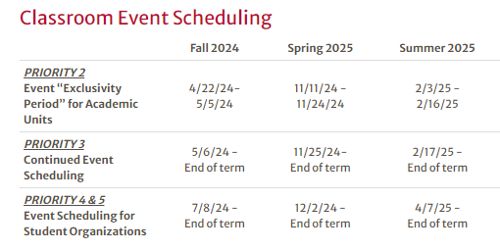
Scheduling Events in 25Live
Sample
When can I schedule events?
The Centralized Classroom Scheduling Calendar is available on the Registrar’s Office website. It provides the dates that departments can start scheduling Priority level two and three events.
***If events are scheduled before the mass central scheduling period, they will be dropped to open the space for Priority 1 course scheduling.

Slide 12
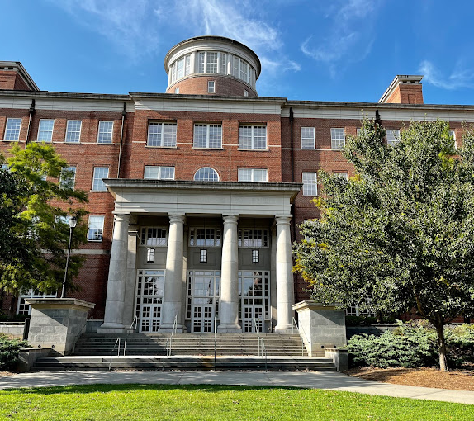
Course Roll and assigning classrooms
How do I secure classrooms for my courses?

Slide 13

Course roll and scheduling classrooms in predesignated spaces during the exclusivity period before the mass central scheduling.
  Classrooms do not roll term to term.
  What is the department’s responsibility?
    Course schedulers should load as many courses as possible in their department's pre-designated spaces before central scheduling.
    If a room is not needed, please enter NCRR for the building and room.
  Which classrooms can I schedule my courses in before central scheduling?
    Only your department’s pre-designated spaces. If an instructor wants to schedule a course in another department’s classroom, that information should be added to the preference form and submitted to the classroom scheduling team prior to the mass central scheduling period.

Slide 14
Best Practices for Improved Utilization
    Schedule courses equally during the Tuesday/Thursday and Monday/Wednesday/Friday periods. Per the Centralized Classroom and Event Scheduling Policy, units should not schedule more than 50% of their courses by prefix on Tuesday/Thursday or more than 50% of the courses between 10 am – 2 pm on any day of the week.
    Maximizing Seat Usage:
      Enter the max enrollment based on the previous term’s actual enrollment. Due to increased enrollment, the demand for large classrooms has increased. If the max enrollment is based on need rather than desired space, this will help better accommodate the actual need for rooms. (This is applicable to your pre-designated spaces, and rooms outside of your building.)
      Schedule your courses in appropriately sized rooms in your pre-designated spaces. Placing low-enrollment courses in larger spaces than needed is a major disadvantage for high-enrollment courses requiring large spaces. Please be mindful of this and do not schedule courses in spaces better suited for larger classes.
    Do not block classrooms. Departments are prohibited from blocking or creating faux courses to hold classrooms for FYO, GradFIRST, Office Hours, etc.
    Load courses during standard periods. This will help maximize instructional space usage and prevent conflicts with students’ schedules and final exam room assignments. Non-Standard Period Course Scheduling Policy

Slide 15

Fair
Equitable
Judicious
Improved
Utilization
  Should I contact another department for permission to load a course in one of their pre-designated, centrally schedulable spaces?
  We strongly discourage the practice because it is not an equitable or judicious process for scheduling classrooms. It does not follow the spirit or intent of the central scheduling policy, and it is a disadvantage to other departments. During our data checks before the mass central scheduling period, the classroom scheduling team may assume you have loaded the room without permission, resulting in dropping the classroom.
  What if a department asks to schedule a course in one of our pre-designated, centrally schedulable spaces?
  This is not allowed. Instead, instruct them to add the building and room on the preference sheet. Their request will be considered and optimized during the mass central scheduling period.
  ***You can load courses in non-centrally schedulable spaces with permission from the controlling department.

Slide 16

Someone scheduled a course
in our department’s pre-designated space
without permission!!!
What do I do?
No worries! Please notify the Registrar’s Office if this occurs. We will remove the building and room from their course and contact the departmental course scheduler. They can submit their request for the room on the preference sheet.
Are departments allowed to schedule a course or event in our department’s pre-designated, non-centrally coordinated spaces?
No. Departments, including the Registrar’s Office and CRETS, must obtain permission from the controlling department before scheduling a course or event in a non-centrally coordinated space. For example, the Registrar’s Office will contact the controlling department for permission to load an FYO or GradFIRST seminar in a non-centrally coordinated space.

Slide 17

What’s Next?
Mass Centralized classroom scheduling period

Slide 18
Mass Centralized Classroom Scheduling
  Centralized Classroom and Event Scheduling Timelines
  The mass centralized classroom scheduling and event scheduling dates are published on the Registrar’s website calendars. Centralized Classroom and Event Scheduling Calendar
  Mass Centralized Classroom Scheduling Period
  The mass central scheduling period occurs twice a year during a two-week period: once for the fall term and once for the spring and summer terms. During this period, the Registrar’s Office assigns classrooms to courses that were not scheduled in a department’s pre-designated spaces.
  Departments have until the exclusivity deadline to load their courses in their pre-designated spaces. All courses that do not require a classroom should be loaded with NCRR in Banner's building and room fields. If you have questions about loading courses, please refer to the Banner Training Materials or email regsched@uga.edu for assistance.

Slide 19
Mass Centralized Classroom Scheduling
  It is important to note that departments are strictly prohibited from creating faux courses to reserve rooms. This action is considered a violation of the Provost Policy.
  If an instructor requires a classroom outside their department’s pre-designated spaces, please:
  Load the course(s) with the appropriate days and times.
  Add the accurate max enrollment.
  Add a cross-listed identifier if needed.
  Leave both the building and room fields blank.
  Add their room request to the preference form, and it will be optimized with the other requests.
If a course was scheduled in a classroom during a previous term, it does not mean you will receive the same room during central scheduling or that you have permission to load the course in the previous space.

Slide 20
Mass Centralized Classroom Scheduling Checklist
  Run the ARGOS Schedule of Classes Proof Report and check the following:
  Load NCRR into BOTH the building and room fields if a classroom is not needed for a course.
  Are the building and room fields blank if the course needs a classroom?
  Is the course's accurate day, time, and maximum enrollment entered in Banner?
  Are the courses cross-listed correctly with a max enrollment entered for the combined sections on the Banner cross-list page (SSAXLST)?
  Is the Instructor of Record listed on back-to-back courses?
  Is NOFR entered as the meeting type on ALL course meetings that will not require a final exam space? (Multiple meeting patterns, evening tests, online exams, etc.)

Slide 21
Submitting Preference Forms
  When do I submit my department’s classroom preferences?
  Approximately three weeks before the mass central scheduling period, a notification email will be sent via the CLASS_SCHEDERS-L@LISTSERV.UGA.EDU with instructions and dates for submitting classroom preferences.
  Requests are not processed on a first-come, first-served basis. The information is imported into the 25Live optimizer, which uses a complex algorithm to place courses in classrooms.
  Departments must use the Registrar’s Office preference form to submit their location preferences and specific requirements prior to central classroom scheduling.

Slide 22
Submitting Preference Forms
How do I fill out the preference form?
The form is designed to cater to your specific needs, allowing you to request classrooms that are not located in your department’s home area or for specific preferences/requirements. You have the flexibility to indicate up to three preferred buildings and one individual classroom on the form. If your preferred building is not on the form, it is because the building has no centrally-scheduled classrooms.
A classroom preference form does not need to be completed for every course that requires a room – only for courses that may have specific needs that differ from the default setting of general classroom space nearby.
Please only include one course per form. You do not need a separate form for cross-listed courses.

Slide 23
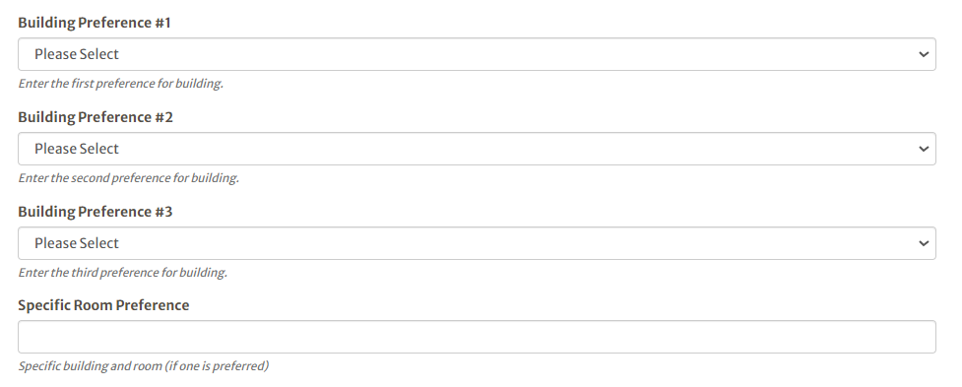
Building and Room Preference Section

Slide 24
Submitting Preference Forms
Required vs. Preferred
Please note the difference between a REQUIRED room feature and a PREFERRED room feature. If a specific room feature, such as technology or desired seating arrangement, is entered as REQUIRED, 25Live will only consider locations with the entered requirement. If the system cannot find an available room of the proper size with all listed requirements, 25Live will not place the course in a classroom. If a seating style or specific technology is pedagogically necessary for teaching the section, please indicate so on the form. However, they should be listed as PREFERRED if they are not requirements.

Slide 25
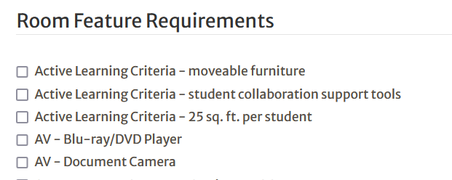
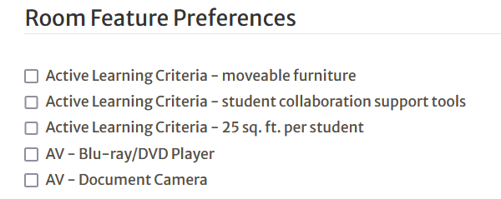
Required vs Preferred Features Section

Slide 26
Submitting Preference Forms
Preference Form FAQ’s
25Live’s default general preferences set for each subject code include any general classroom large enough to hold the expected course enrollment near the home department location.
Forms must be filled out correctly to be accepted. Accurate data will help us better understand your request and result in a better outcome.
If you are unable to accommodate a faculty disability request in your pre-designated rooms, you may list the instructor’s specific needs on the preference form.
Submitting a preference form does not guarantee that the room will be reserved.

Slide 27

Why wasn’t my course scheduled in a room?
There are several reasons why a course may not receive a room during mass central scheduling.
The requested space may have been pre-reserved by the controlling department.
Classrooms fill quickly during the Tuesday/Thursday “prime-time” periods, (9:35 a.m. – 3:35 p.m.).
There may not be any classrooms available that will accommodate the maximum enrollment. This is very common for larger classrooms.
We didn’t get a room!!!
What now?

Slide 28


EVERYTHING IS POSSIBLE, EVEN THE IMPOSSIBLE
The Registrar’s Office will work with you to locate an available classroom during a different period or room capacity.

Slide 29

How do I request a classroom after central scheduling?
  You do not need to fill out another preference form. The preference form is exclusively used for mass central scheduling. To request a classroom assignment or room change, please email classrooms@uga.edu. The Registrar’s Office will respond within two business days.
  Course classroom changes should not be submitted on the 25Live event form. The form is exclusively used for scheduling events in 25Live.
  It is the department’s responsibility to make sure that all courses are scheduled in a classroom. We do not notify departments if we are unable to secure a room for every course.

Slide 30
How do I change classrooms in Banner
after central scheduling?
  To change an existing classroom from one space to another, please email the request to the Registrar’s Office, and we will make the change for you to prevent double-booking a classroom.
  If classrooms are double-booked in Banner, 25Live will drop the classroom from both courses or the course and event.
  Banner will only show a conflict with another course. It will not give you a conflict error if an event is scheduled in a classroom.
  The override indicator in Banner should only be used for cross-listed courses or classes with an NCRR location. If the override indicator is used on other types of courses, Banner will not generate a room conflict error. This practice can potentially result in a double-booked classroom.
  If courses need to be scheduled in the same room at the same time but not cross-listed, please email classrooms@uga.edu. We can manually bind them in 25Live.

Slide 31
Students and Classroom Changes
  Banner, Athena, and 25Live are synchronized. If a room assignment is changed in Banner or 25live, Athena will reflect the new room assignment. Students will receive a notification from Athena when a course change has occurred.
  Disability room request: if a student requests a disability accommodation due to mobility issues, please email classrooms@uga.edu. We will try to locate an alternative classroom.

Slide 32

Provost Policy for FYO Scheduling
An instructor has two options for scheduling a classroom for their FYO Seminar:
Choose one of the pre-reserved classrooms listed on the FYO portal.
Submit their room preference on the FYO portal. If the room is available, the Registrar’s Office will reserve it.
The FYO and Registrar’s Office classroom scheduling team are responsible for updating Banner, Athena, 25Live, and the FYO portal. It is essential that we schedule the classroom to ensure that all systems are updated with the correct information for student’s convenience and USG data reporting purposes.

Slide 33


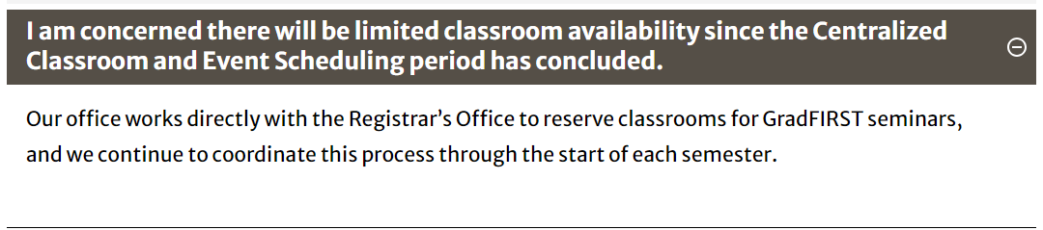
GradFIRST FAQs
The GradFIRST coordinator will send the instructor a Qualtrics form to submit classroom preferences. The Registrar’s Office will assist the GradFIRST coordinator with reserving those spaces.
If a specific room is not requested, we will gladly look for an available space.

Slide 34
Requests for a non-centrally coordinated space
Often, instructors request a non-centrally coordinated space for their FYO or GradFIRST seminar. In these instances, the Registrar’s Office contacts the department that controls the space for permission to reserve the room for the seminar. Scheduling a room on an internal calendar does NOT officially reserve the classroom for a seminar.
Departments must not create events in 25Live, faux courses in Banner, or reserve rooms on an internal scheduling calendar for FYO and GradFIRST seminars. This is a violation of Provost Policy.

Slide 35
Scheduling a Non-Standard Period Course
  Non-Standard Period Policy Number 01.03.006
  Procedure to Request Off-Schedule Course Sections
  Daily Class Schedule
  Monday, Wednesday, and Friday class periods are divided into 50-minute segments, and those on Tuesdays and Thursdays are 75 minutes. Classes must be scheduled and taught during the designated class periods at the designated times. All exceptions must be approved by the department head, dean, and the vice president for instruction in advance of their listing in Athena. This policy is needed to make full use of classroom space and offer students the widest possible choice of classes and time periods.
  Scheduling courses during a non-standard period adversely affects classroom utilization, final exam scheduling, and student schedules.
  Undergraduate courses scheduled during a non-standard period should be scheduled after 2 p.m. if possible.

Slide 36
Evening Test Policies and Procedures
Request forms should be submitted to the Office of the Registrar (currsys@uga.edu) at least one month prior to the beginning of registration. Departments will be notified of approval or denial via email. Approval is granted for one semester and must be requested each semester evening tests will be offered.
After departments have loaded their evening test meeting days and times in Banner, they may request classroom assignments from the Office of the Registrar at classrooms@uga.edu. These requests should include the following:
Term
CRN of the course
Number of required seats
Any location or room feature preferences
Evening tests are scheduled in 25Live as Academic Test events. The Registrar’s Office will send a work request to FMD to open and close the building and rooms.

Slide 37
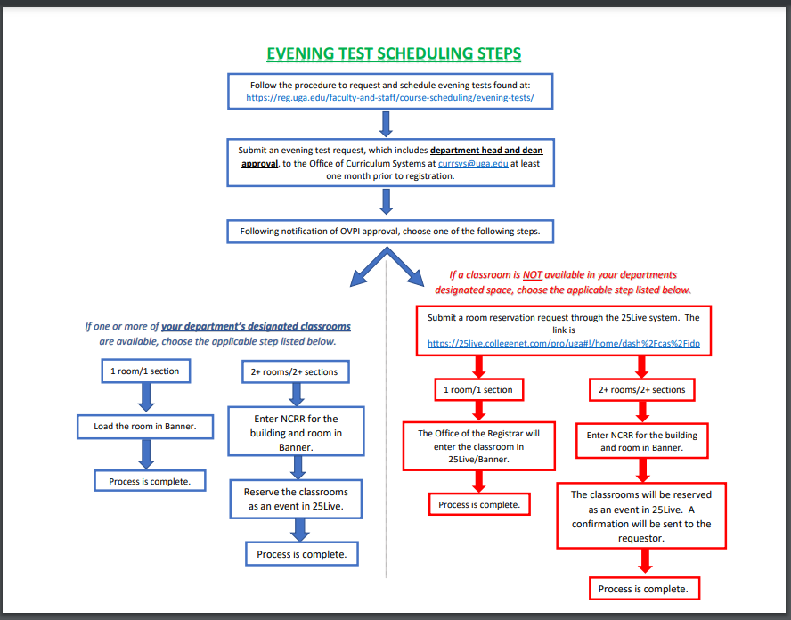

Slide 38
Final and Mass Exam Classroom Scheduling
Final Exam Calendar, Policies, and Procedures
When are final exam room assignments scheduled?
The Registrar’s Office makes final exam room assignments. The assignments are published one month before the first day of final exams. Once the process is complete, an email notification will be sent to the class schedulers' listserv.
How do I request a specific room for my final exam?
To request a specific room for your final exam, please email classrooms@uga.edu after the room assignments have been published.
25Live will schedule final exams in non-centrally coordinated spaces if the regular course meeting is in the room.
If a classroom is not required for a final exam, please enter NOFR for the Meeting Type field in Banner. For example, multiple meeting pattern courses do not need a final exam room assignment during both periods. NOFR indicates no final exam classroom is required.

Slide 39
Final and Mass Exam Classroom Scheduling
Final Exam Calendar, Policies, and Procedures
How are mass final exams scheduled?
An email will be sent to the departments that have received prior approval to offer mass final exams requesting their preferred spaces.
The Registrar’s Office will reserve those rooms and coordinated FMD to open/close the building and rooms.
If a department receives permission to offer a mass final exam, ALL sections of the course must participate in the mass final.
Enter NOFR in the Meeting Type field in Banner for these courses.

Slide 40
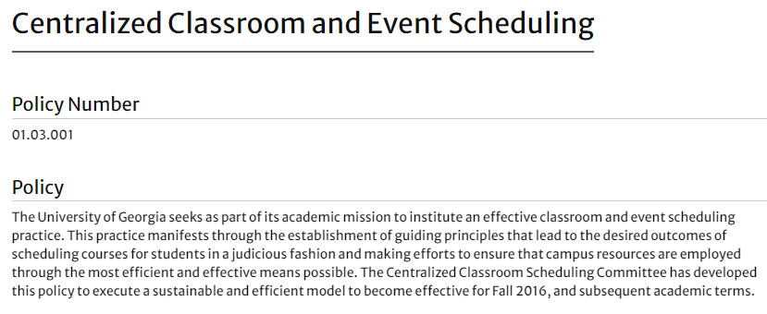
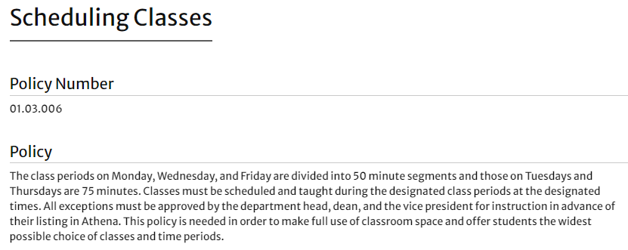
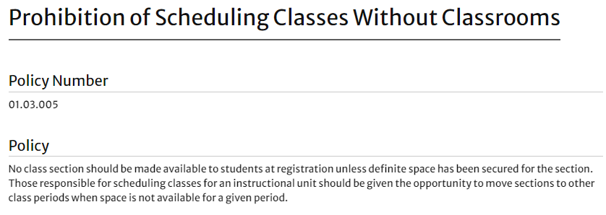
Policy Library for Classroom Management

Slide 41
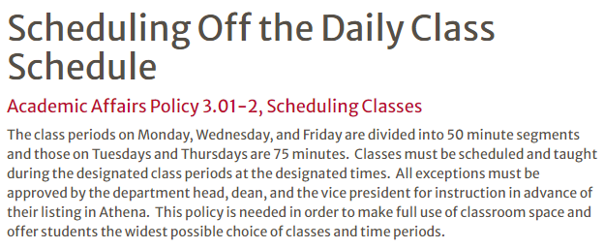
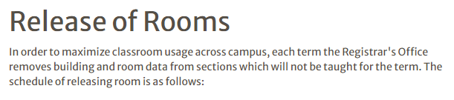
Policy Library for Classroom Management
Registrar Action | When
Held rooms will be released for any 'A's and 'P's with zero (0) maximum enrollment and zero (0) enrollment. | Weekly, beginning at the end of the Central Scheduling Period.
Held rooms will be released for any remaining 'A's with (0) enrollment. | Daily, beginning the first day of Drop/Add.
Convert 'P's to 'C's. | Once a term on the first business day after last day of drop/add per applicable part of term.

Slide 42

The Registrar’s Office Classroom Scheduling Team
We are here to assist with classroom reservations for courses, course-related events, and final exam room assignments.
You can reach us at classrooms@uga.edu
Wendy Moore, Assistant Registrar
Lesia Woodall, Coordinator for Academic Classroom Reservations

